Slide 1

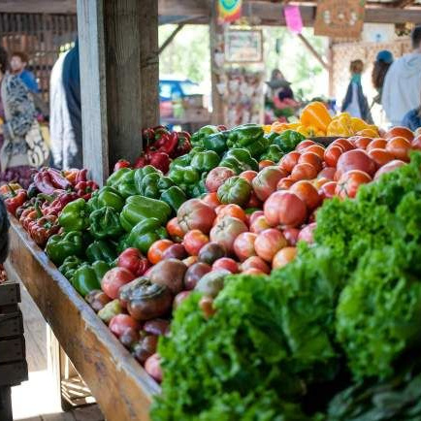
Welcome to Our City Market
Exploring yummy food in the big city!

Slide 2

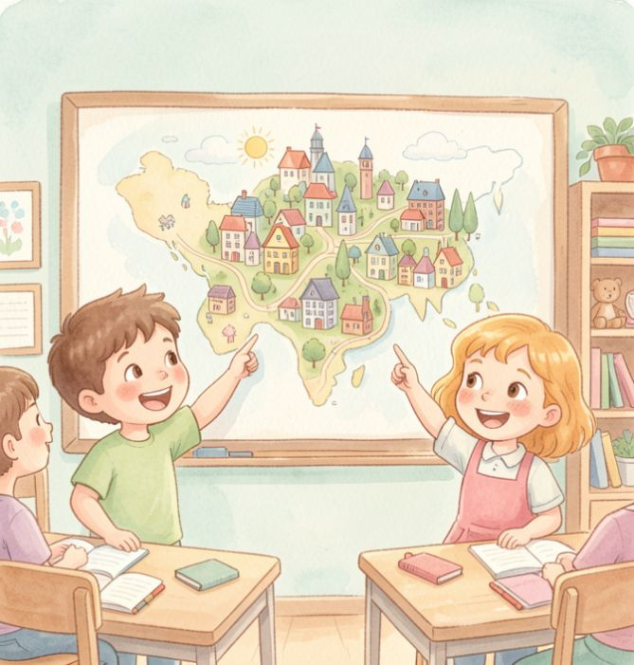
Today's Adventure
We are going to:
Play a fun movement game.
Visit a city market.
Describe food and colors.
Draw a picnic.

Slide 3
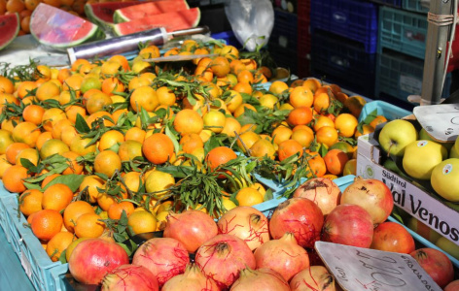
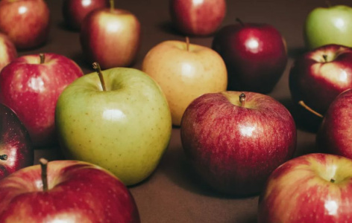
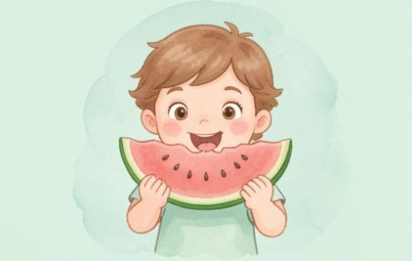
Our Market Words
Market
A place where we buy fresh food.
Healthy
Food that makes your body strong.
Favorite
The food you like the very most!

Slide 4
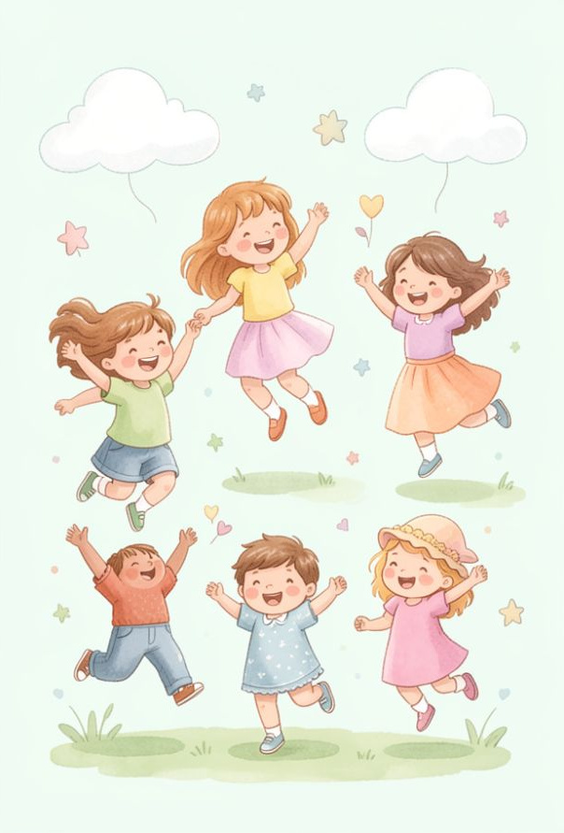
Freeze Dance Warm-Up!
Let's move! When the music plays, dance around like you are walking through a busy city. When the music stops... FREEZE!
🔍
Example
Can you freeze like a statue in a park?

Slide 5
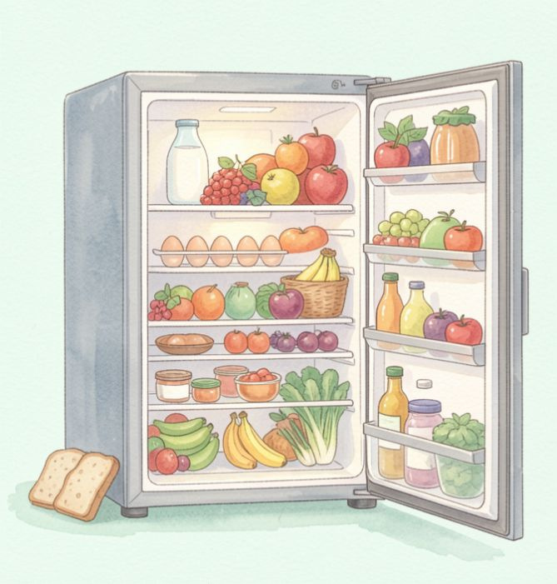
What's in the Fridge?
Look inside! Every morning, city families open their refrigerators. What do you see?
🤯
Fun fact
Most city food comes from farms and travels to the market!

Slide 6
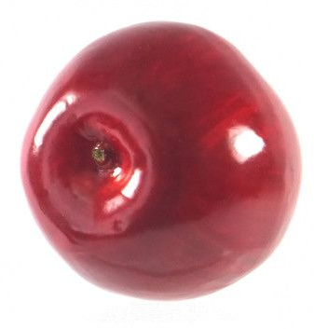
Naming our Food
To talk about food, we say:
"This is a..."
🔍
Example
Point to the picture and say: "This is an apple."

Slide 7
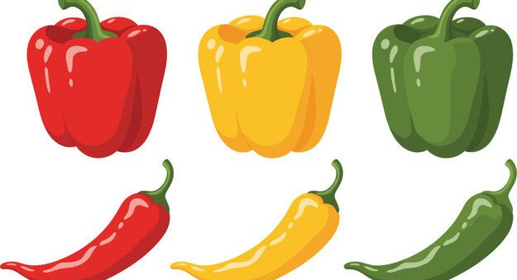
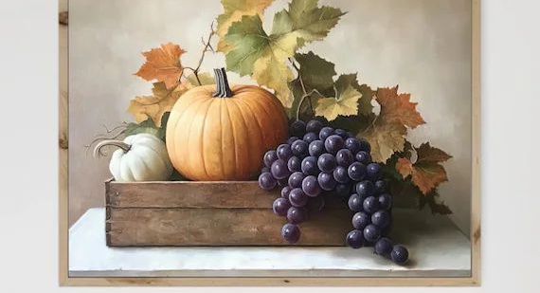
Colors and Sizes
We can describe our market finds using colors and sizes!
Colors
It is red, yellow, or green.
Sizes
It is big or small.

Slide 8
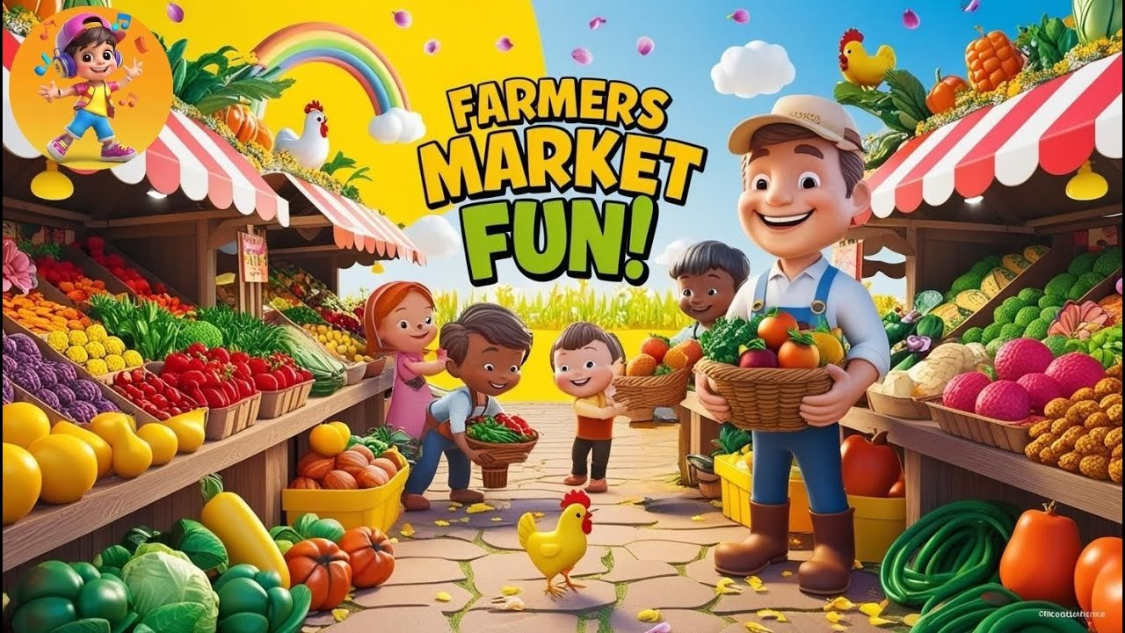
Watch the Market!
Let's see all the different foods people find in the city market.
▶

Slide 9
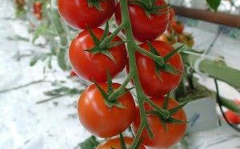
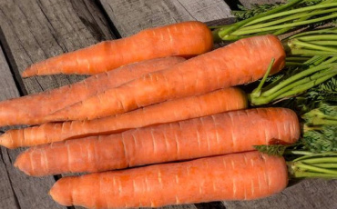
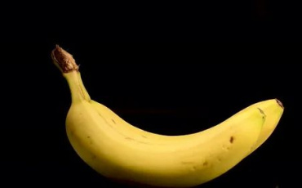
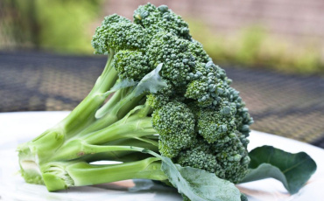
Match the Market Food!
1.
Yellow Banana
a)
b)
2.
Red Tomato
3.
Green Broccoli
c)
d)
4.
Orange Carrot

Slide 10
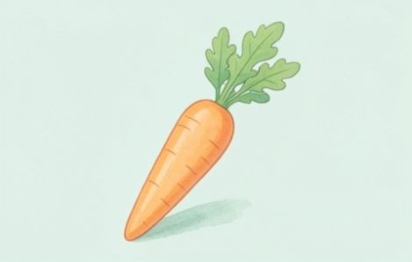
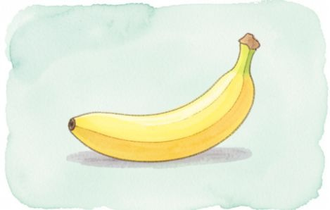
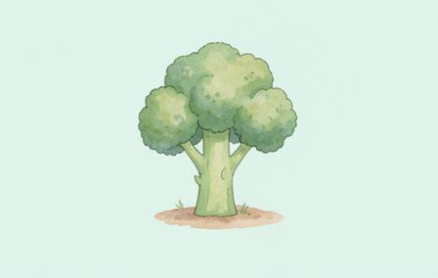
Fresh From the Market
Look at these market foods! Can you name them?
Carrot - A crunchy vegetable.
Banana - A yellow fruit.
Broccoli - A green vegetable.

Slide 11
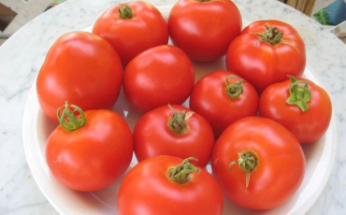
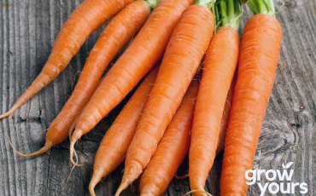
Match the Market Food!
✅​
c)
a)
1.
Yellow Banana
2.
Red Tomato
d)
b)
3.
Green Broccoli
4.
Orange Carrot

Slide 12
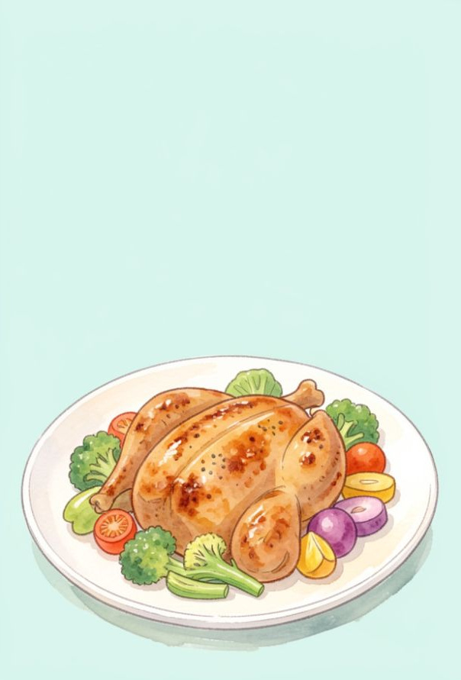
My Favorite Meal
What do you love to eat?
You can say:
"My favorite meal is..."
🔍
Example
My favorite meal is chicken and rice.

Slide 13
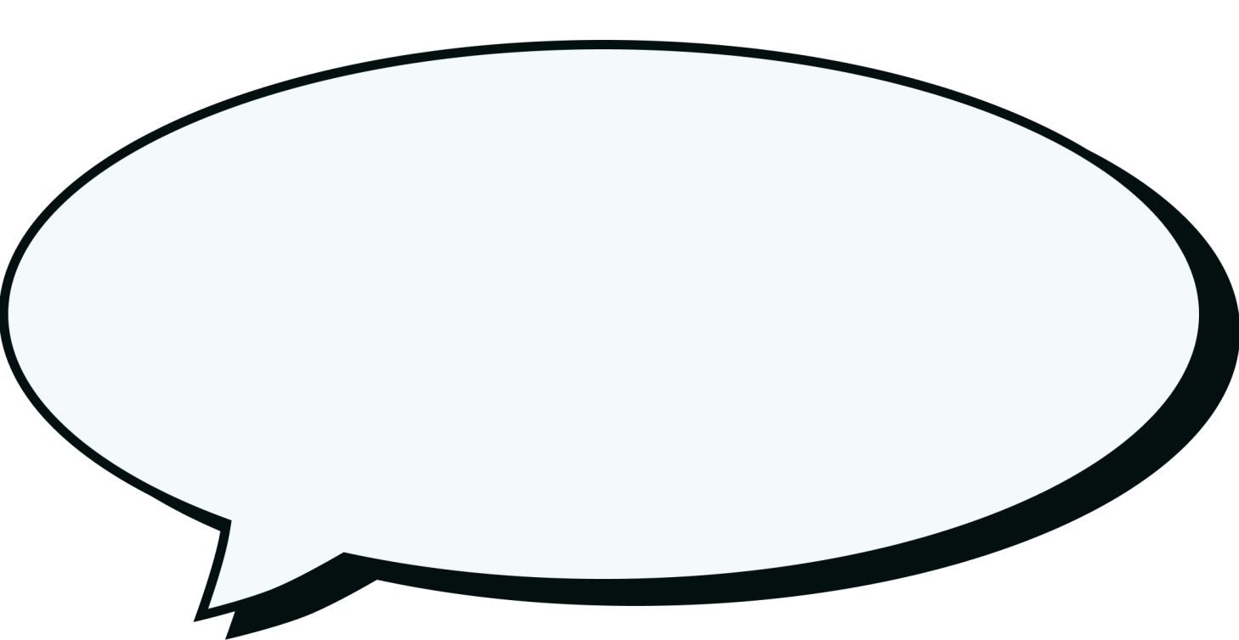
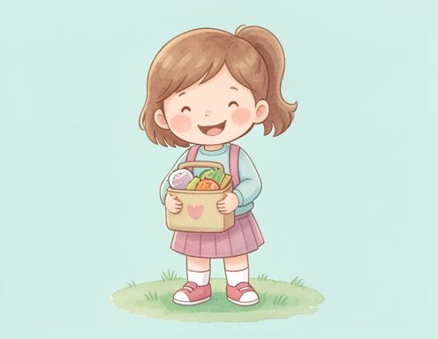
Sharing Feelings
How do you feel when you eat your favorite healthy food?

Slide 14
Sharing Feelings
✅​
You might have said...
I feel happy!
I feel strong.
I feel excited.

Slide 15
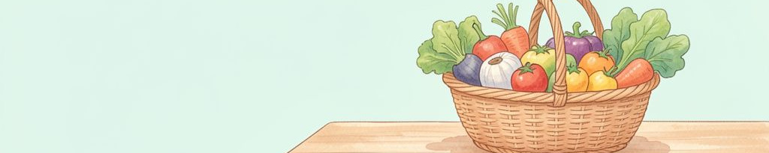
The Grocery Basket
When we shop, we fill our basket with colors!
🧠
Remember
Healthy foods like fruits and veggies help us grow.

Slide 16
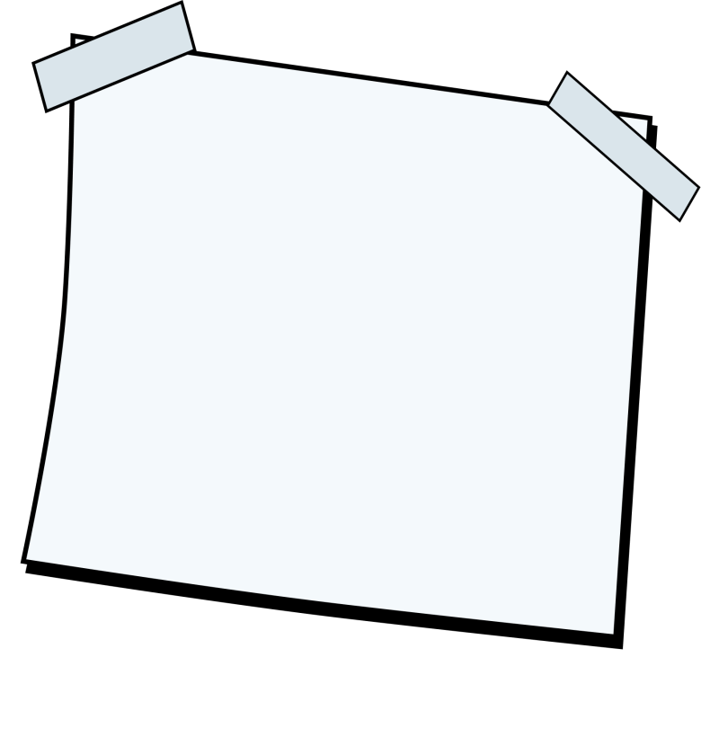
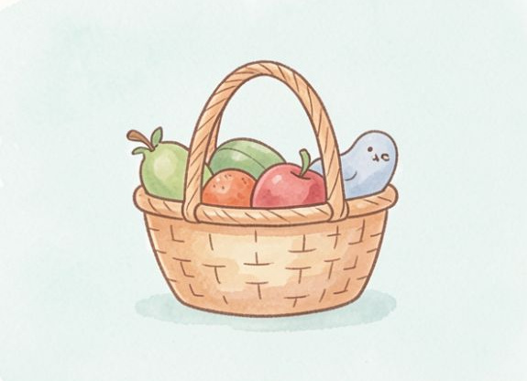
Design Your Picnic Basket
Draw a big picnic basket! Inside, draw 3 of your favorite healthy foods. Use your best colors!
What you'll need: 🎨​ 🖌️​
Paper, Crayons, Markers

Slide 17
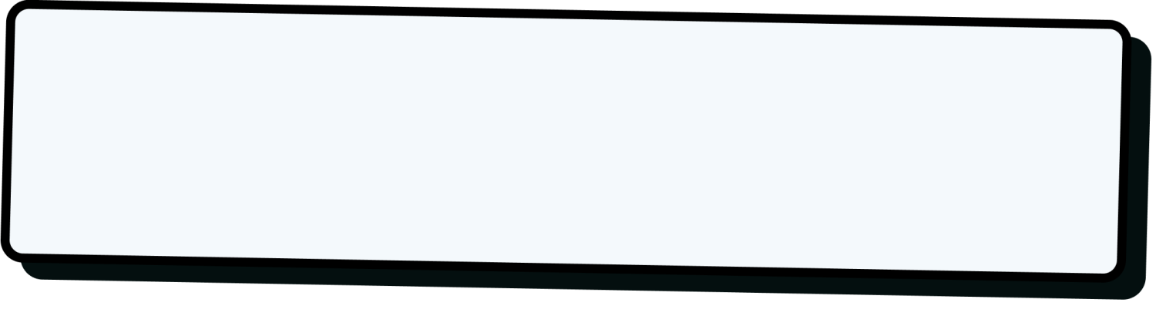
Market Review
This is an apple. It is ____ and ____.
Word bank 🏦​
big, blue, red, small
Answers on the next slide...

Slide 18
Market Review
✅​
This is an apple. It is red and small.
Word bank 🏦​
big, blue, red, small

Slide 19
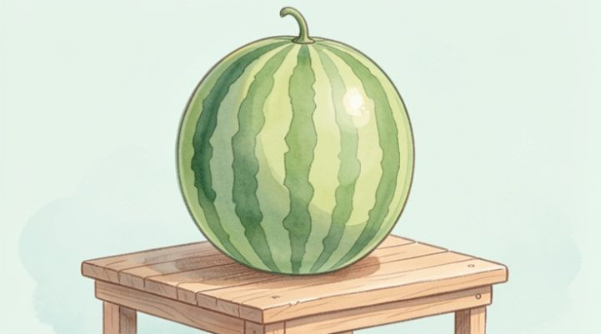
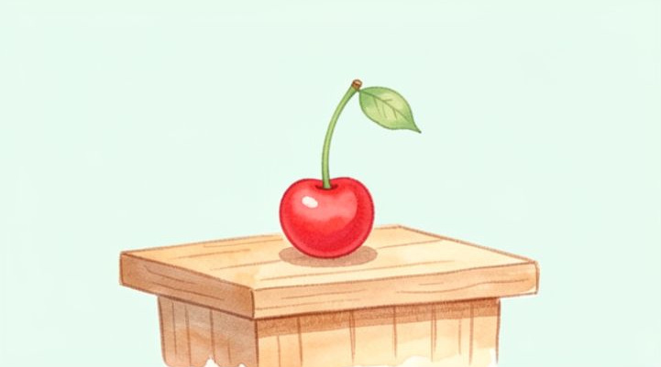
Big and Small Market Foods
Market foods are big or small.
Big Food
Melons are big.
Small Food
Cherries are small.

Slide 20
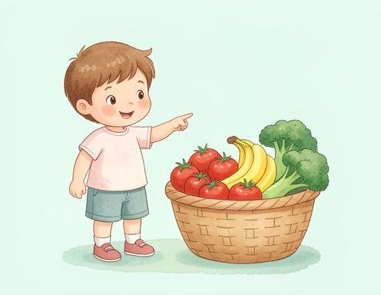
Your Favorite City Food
What is your favorite food from the market? Is it a big, red apple or a small, green grape?

Slide 21
Your Favorite City Food
✅​
You might have said...
My favorite food is a banana. It is yellow!
This is a carrot. It is orange and crunchy.
I like broccoli. It is green and looks like a tree!

