Slide 1

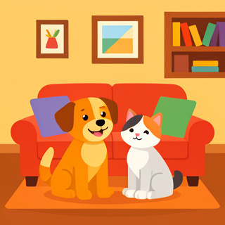
PETS AT HOME
Body Parts and Where They Are!

Slide 2

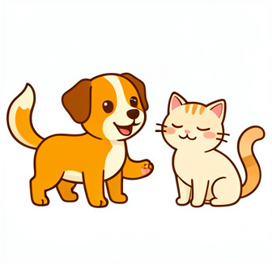
MEET OUR PETS
Our Furry Friends
Today, we will look at pets.
Pets are animals that live with us.
Do you have a pet?
What kind of animal is it?

Slide 3

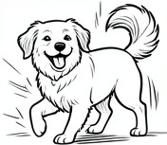

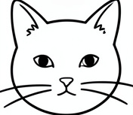
PET BODY PARTS
1
2
3
4
Ears
Pets use ears to hear sounds.
Tail
Pets wag their tail when happy.
Paws
Pets walk on four paws.
Whiskers
Long hairs on the face.

Slide 4
MATCH THE WORDS WITH THE DEFINITIONS 🎯​
1.
Paw
a)
We hear sounds with this.
2.
Whiskers
b)
This wags when a dog is happy.
3.
Tail
c)
Long hairs on a cat's face.
4.
Ear
d)
Cats walk on these four feet.

Slide 5
MATCH THE WORDS WITH THE DEFINITIONS 🎯​
✅​
1.
Paw
b)
This wags when a dog is happy.
2.
Whiskers
c)
Long hairs on a cat's face.
3.
Tail
a)
We hear sounds with this.
4.
Ear
d)
Cats walk on these four feet.

Slide 6
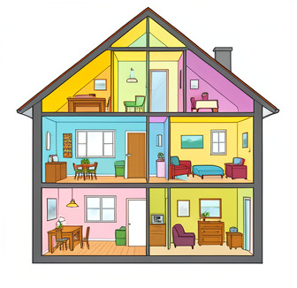
ROOMS IN A HOUSE
Where Pets Play
Pets live in our house with us.
A house has different rooms.
Let's learn the names of the rooms!

Slide 7
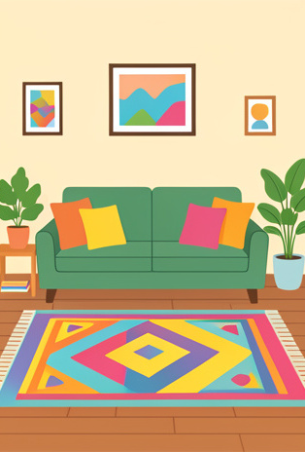
EXPLORE THE ROOMS
1
Living Room
We watch TV and relax here.
2
Kitchen
We cook yummy food here.
3
Bedroom
We sleep in our beds here.
4
Garden
Plants grow outside here.

Slide 8
WHERE DO WE COOK?
Answers on the next slide...
Which room is for cooking food?
1.
Bedroom
2.
Kitchen
3.
Garden
4.
Garage

Slide 9
WHERE DO WE COOK?
✅​
Which room is for cooking food?
1.
Bedroom
2.
Kitchen
👍​
3.
Garden
4.
Garage

Slide 10
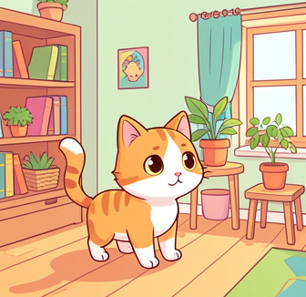
PREPOSITIONS OF PLACE
Where is the Cat?
We use special words to say where things are.
These words tell us a position.
They are called Prepositions!

Slide 11
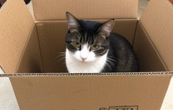
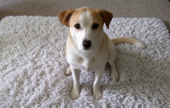
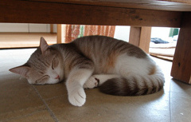
KEY PREPOSITIONS
In
Inside a box or room.
On
On top of a surface.
Under
Below something.

Slide 12
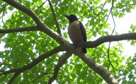
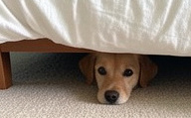
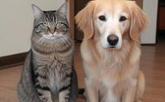
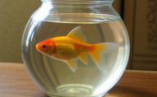
MATCH THE WORDS WITH THE PICTURES 🎯​
1.
In
a)
b)
2.
On
3.
Under
c)
d)
4.
Next to

Slide 13
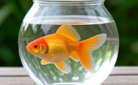
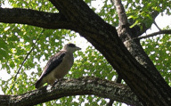
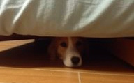
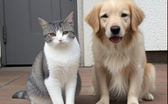
MATCH THE WORDS WITH THE PICTURES 🎯​
✅​
d)
a)
1.
In
2.
On
b)
c)
3.
Under
4.
Next to

Slide 14

FILL IN THE BLANKS 🧩​
The cat is ____ the box.
Word bank 🏦​
in, on, under, at
Answers on the next slide...

Slide 15
FILL IN THE BLANKS 🧩​
✅​
The cat is in the box.
Word bank 🏦​
in, on, under, at

Slide 16

TRUE OR FALSE ✅​ ❌​
The dog is under the table.
👍​
👎​
TRUE
FALSE
Answers on the next slide...

Slide 17
TRUE OR FALSE ✅​ ❌​
✅​
The dog is under the table.
👍​
TRUE
Under means the dog is below the table.

Slide 18
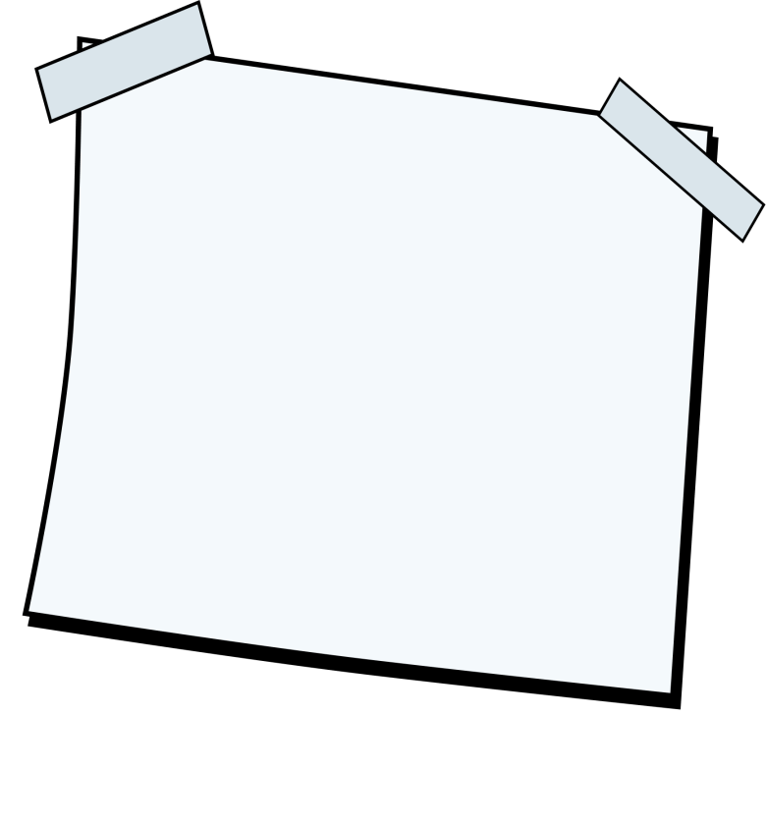
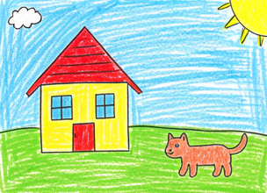
GET CREATIVE 🖼️​
Draw your pet in a room! Place your pet in, on, or under something in the room.
What you'll need: 🎨​ 🖌️​
Paper, Crayons or Markers

Slide 19

GREAT JOB!
You Did It!
Today you learned:
Body parts of pets (ears, tail, paws).
Rooms in a house.
Prepositions like in, on, and under.
Keep practicing at home!

