Slide 1

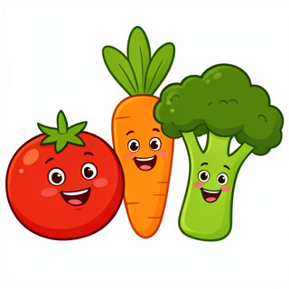
Vegetable Adventures!
Learning to use 'There is' and 'There are'

Slide 2
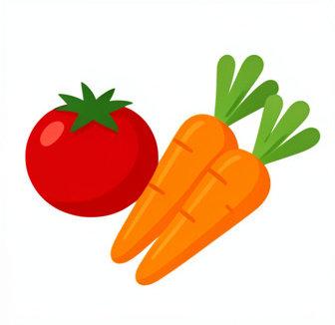
Meet our Veggie Friends
What do we see?
Look at all these yummy vegetables! We have colorful tomatoes, crunchy carrots, and round onions.
How many are there?
When we talk about one thing, we use special words. When we talk about many things, we change our words!

Slide 3
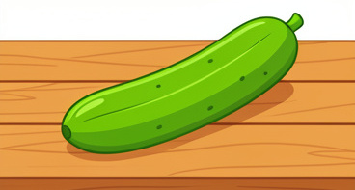
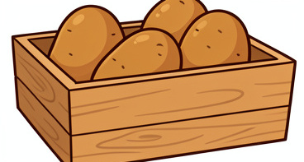
There Is vs. There Are
We use There is when we see only ONE vegetable.
We use There are when we see TWO or MORE vegetables.

Slide 4
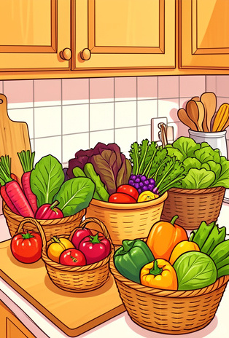
Let's Practice Tracing!
1
One Tomato
Trace this: There is a tomato on the table.
2
One Carrot
Trace this: There is a carrot in the basket.
3
Many Cabbages
Trace this: There are cabbages under the counter.

Slide 5
Veggie Word Match
1.
Onion
a)
A round red vegetable
2.
Carrot
b)
A long orange vegetable
3.
Cabbage
c)
A white or purple vegetable that can make you cry
4.
Tomato
d)
A big green leafy vegetable

Slide 6
Veggie Word Match
✅​
1.
Onion
c)
A white or purple vegetable that can make you cry
2.
Carrot
b)
A long orange vegetable
3.
Cabbage
d)
A big green leafy vegetable
4.
Tomato
a)
A round red vegetable

Slide 7
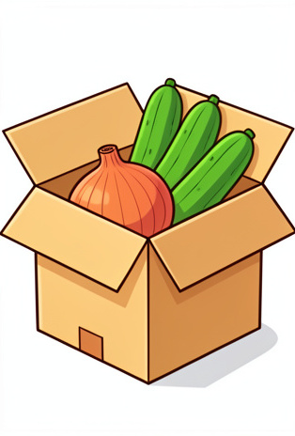
Look and Write
What is in the box?
Look closely at the picture. If you see one, start with There is. If you see many, start with There are.
Try writing these sentences down in your notebook!

Slide 8
Choose the Correct Word
Answers on the next slide...
______ are three carrots in the basket.
1.
There is
2.
There are
3.
They is
4.
This are

Slide 9
Choose the Correct Word
✅​
______ are three carrots in the basket.
1.
There is
2.
There are
👍​
3.
They is
4.
This are

Slide 10
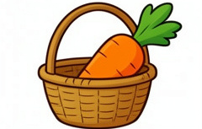
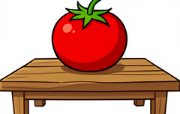
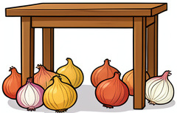
Where are the veggies?
In
There is a carrot IN the basket.
On
There is a tomato ON the table.
Under
There are onions UNDER the table.

Slide 11

Filling the Gaps
1. ______ is a cucumber on the table. 2. ______ are onions under the table.
Word bank 🏦​
There, There, Here, They, Where
Answers on the next slide...

Slide 12
Filling the Gaps
✅​
1. There__ is a cucumber on the table. 2. There__ are onions under the table.
Word bank 🏦​
There, There, Here, They, Where

Slide 13

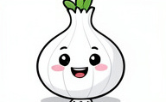

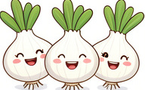
Match the Sentence to the Picture
1.
There is one potato.
a)
b)
2.
There are many potatoes.
3.
There is one onion.
c)
d)
4.
There are many onions.

Slide 14
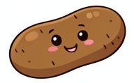

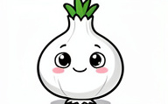
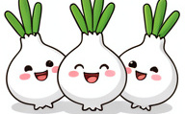
Match the Sentence to the Picture
✅​
c)
a)
1.
There is one potato.
2.
There are many potatoes.
b)
d)
3.
There is one onion.
4.
There are many onions.

Slide 15
Can you spot the mistake?
There are a tomato on the table.
👍​
👎​
TRUE
FALSE
Now it's time to explain why...

Slide 16
Can you spot the mistake?
There are a tomato on the table.
👎​
Why is that?
a) We use 'There is' for one tomato.
b) We use 'There are' for one tomato.
Answers on the next slide...

Slide 17
Can you spot the mistake?
✅​
There are a tomato on the table.
👎​
Why is that?
a) We use 'There is' for one tomato. ✅​
b) We use 'There are' for one tomato.

Slide 18

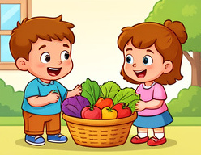
Your Kitchen Counter
Imagine your kitchen. What
vegetables can you see?
Tell your partner using
'There is' or 'There are'.

Slide 19
Your Kitchen Counter
✅​
You might have said...
There is an onion in my fridge.
There are three carrots on my plate.
There is a big cabbage in the bag.

Slide 20
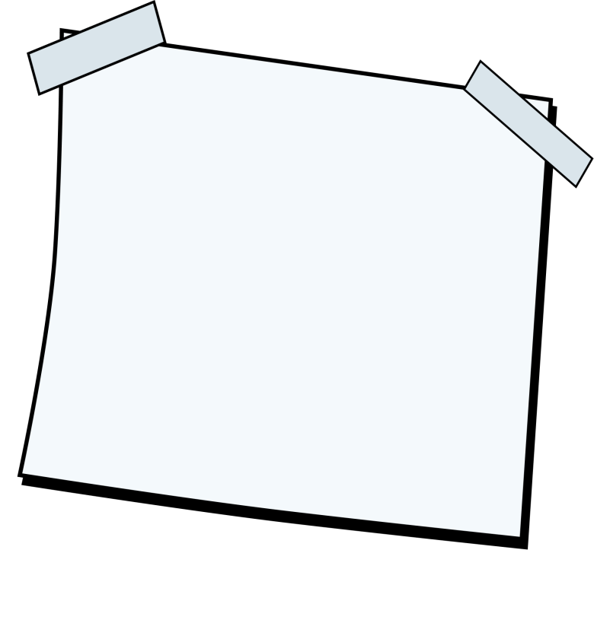
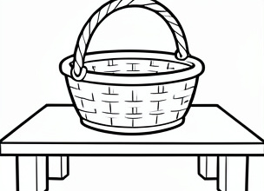
Draw Your Vegetable Scene
Draw a picture with your favorite vegetables in a basket or on a table. Then, write one sentence starting with 'There is' and one starting with 'There are' about your drawing!
What you'll need: 🎨​ 🖌️​
Paper, Crayons, Pencil

Slide 21
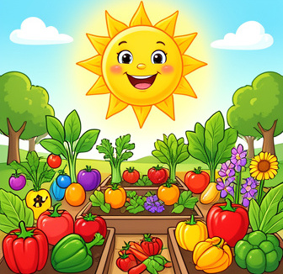
Great Job, Veggie Heroes!
You learned so much today!
There is = 1 vegetable
There are = 2 or more vegetables
Keep practicing every time you go to the grocery store with your family!

