Slide 1
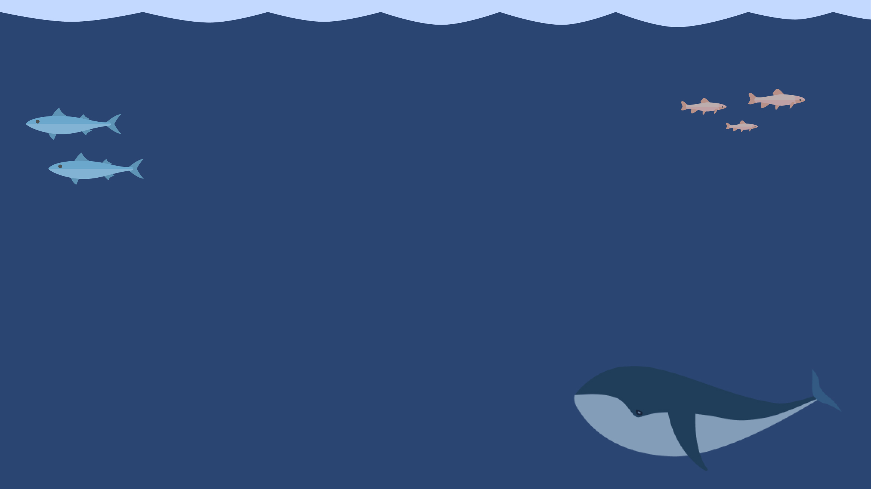

Describing Physical Appearance
What do you look like?

Slide 2

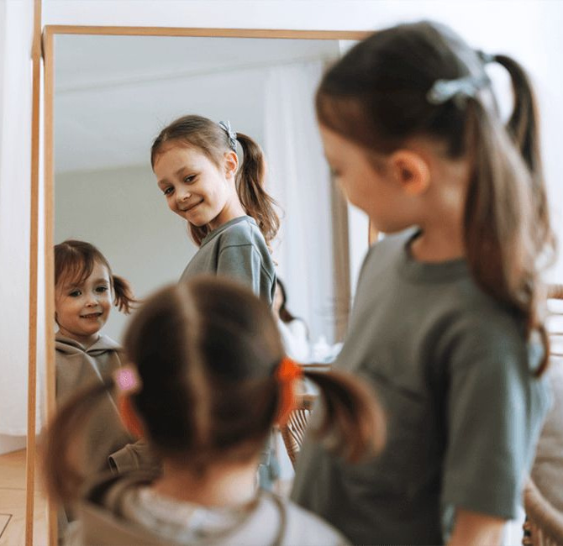
Learning Goals
By the end of this lesson, you will be able to:
Identify physical traits like height, hair, and eye color.
Use the verbs 'have' and 'is' correctly to describe people.
Answer the question 'What does he/she look like?'
Describe a mystery classmate for others to guess!

Slide 3
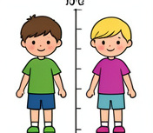

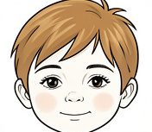

Key Words
Physical Trait
A specific feature of your body, like eye color or height.
Description
Telling details about how someone or something looks.
Appearance
The way someone looks on the outside.
Feature
Facial or body feature, e.g., nose, smile.

Slide 4
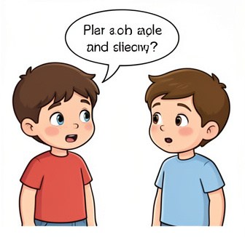
Asking About Appearance
When we want to know how someone looks, we ask:
What does he/she look like?
We use this question to learn about:
Height (How tall are they?)
Hair (What color is it? Is it long or short?)
Eyes (What color are they?)

Slide 5
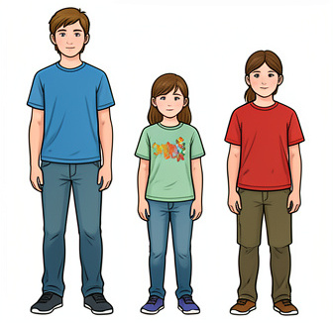
Describing Height
We use the verb is to describe height and build.
Examples:
He is tall.
She is short.
They are medium height.
Remember:
We don't say 'He has tall.' We always use 'is' for height!

Slide 6
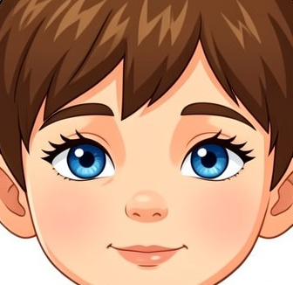
Describing Hair and Eyes
We use the verb has to describe body parts and colors.
Examples:
He has brown hair.
She has blue eyes.
He has curly hair.
She has long hair.
Remember:
We use 'has' because these are things they possess or have on their body!

Slide 7
Have or Is?
Answers on the next slide...
Which sentence is correct?
1.
She has tall.
2.
She is tall.
3.
She are tall.
4.
She have tall.

Slide 8
Have or Is?
✅​
Which sentence is correct?
1.
She has tall.
2.
She is tall.
👍​
3.
She are tall.
4.
She have tall.

Slide 9
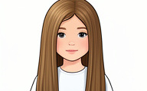
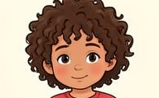
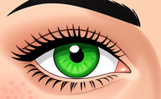

Match the words with the pictures 🎯​
1.
Curly Hair
a)
b)
2.
Glasses
3.
Green Eyes
c)
d)
4.
Long Hair

Slide 10
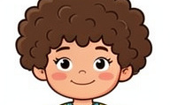
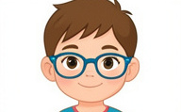
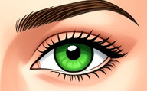
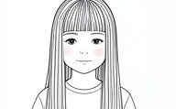
Match the words with the pictures 🎯​
✅​
b)
d)
1.
Curly Hair
2.
Glasses
c)
a)
3.
Green Eyes
4.
Long Hair

Slide 11
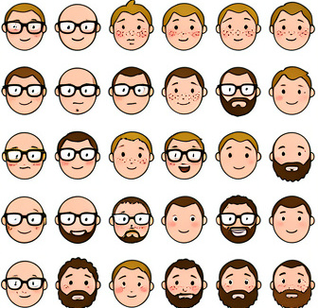
Facial Features
Let's look at smaller details on the face.
Other Features:
Glasses: He has glasses.
Mustache/Beard: He has a beard.
Freckles: She has freckles.
Putting it together:
'She has red hair and freckles.'

Slide 12
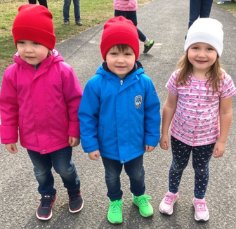
Clothing and Accessories
Clothing helps us identify someone too!
Describing Clothes:
He has a red hat.
She has a blue jacket.
They have green sneakers.
We use has/have because clothes are something you wear or possess.

Slide 13

True or False ✅​ ❌​
We use 'is' to describe eye color. (Example: He is blue eyes.)
👍​
👎​
TRUE
FALSE
Answers on the next slide...

Slide 14
True or False ✅​ ❌​
✅​
We use 'is' to describe eye color. (Example: He is blue eyes.)
👎​
FALSE
We use 'has' for body parts and colors. The correct sentence is: 'He has blue eyes.'

Slide 15

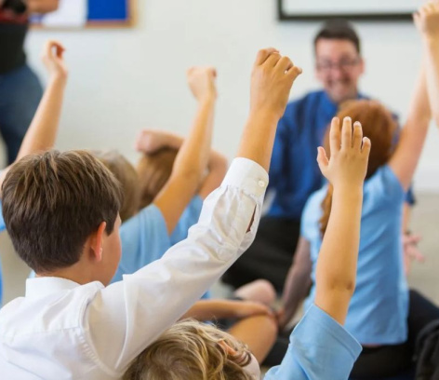
Mystery Classmate Game
Think of a friend or classmate. Write 3 sentences describing what they look like without saying their name. Read your description to the class. Can they guess who it is?

Slide 16

Fill in the blanks 🧩​
My friend Tom ____ short. He ____ brown hair and green eyes. He ____ a red hat too.
Word bank 🏦​
is, has, has, are, have, does
Answers on the next slide...

Slide 17
Fill in the blanks 🧩​
✅​
My friend Tom is short. He has brown hair and green eyes. He has a red hat too.
Word bank 🏦​
is, has, has, are, have, does

Slide 18

Summary
What did we learn?
Use is for height and build (tall, short).
Use has for features, colors, and clothes.
Always ask: 'What does he/she look like?'
You can now describe anyone you meet!

