Slide 1

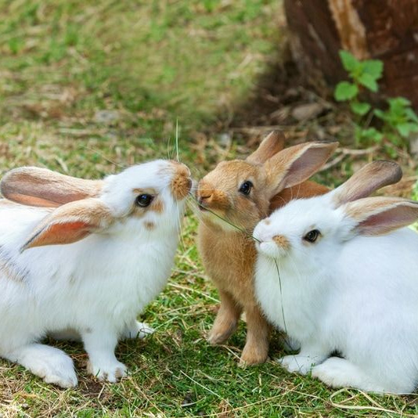
OUR AMAZING PETS!
Learn about animals and what they have.

Slide 2

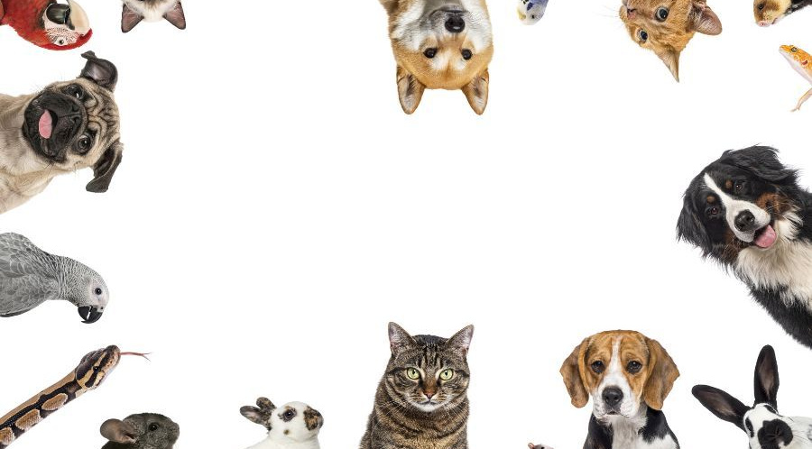
MEET THE PETS
Today, we are going to look at some favorite pets.
We will learn about their special body parts and what they have on their bodies.
Do you have a pet?

Slide 3

USING 'HAVE GOT'
The Rule
We use 'have got' for I, you, we, and they.
Examples
I have got a rabbit.
You have got a nice dog.
We have got two cats.
They have got long ears.

Slide 4
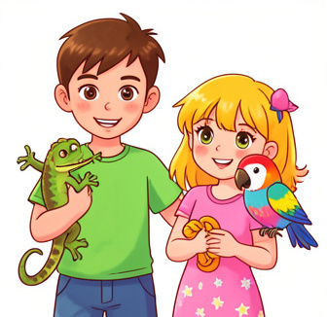
USING 'HAS GOT'
The Rule
We use 'has got' for he, she, and it.
Examples
He has got a lizard.
She has got a parrot.
It (the dog) has got a short tail.

Slide 5
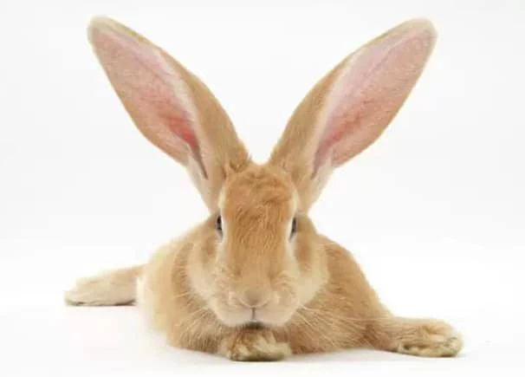
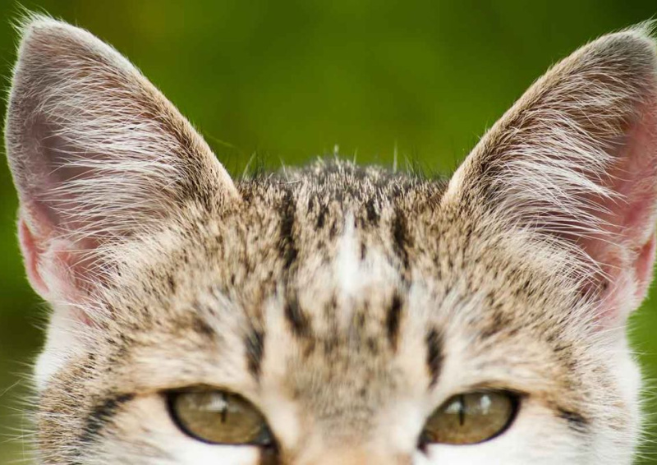
LET'S LOOK AT EARS!
Look how different they are!

Slide 6
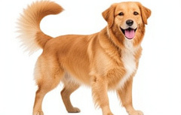
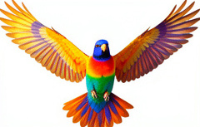

ANIMAL BODY PARTS
1
2
3
The Dog
The dog has got a wagging tail and floppy ears.
The Bird
The bird has got colorful wings and a small beak.
The Rabbit
The rabbit has got long ears and a white tail.

Slide 7
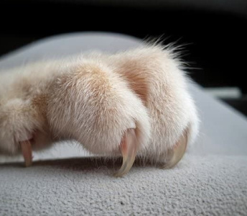
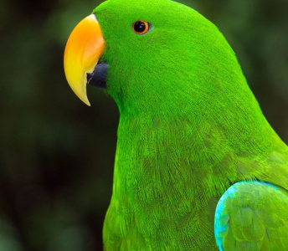
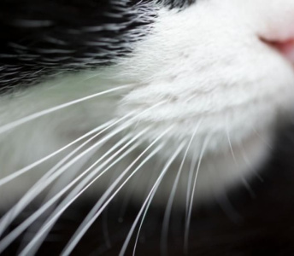
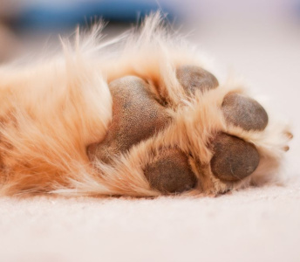
ANIMAL BODY PARTS
1
2
3
4
Claw
This is a claw. The cat has got sharp claws.
Beak
This is a beak. The bird has got a small beak.
Whiskers
Cats have got long whiskers.
Paw
This is a paw. The dog has got four paws.

Slide 8
QUIZ TIME! 🎉​
Answers on the next slide... ➡️​
Which sentence is correct? 🤔​
1.
She have got a cat. 🐱​
2.
She has got a cat. 🐱​
3.
She has get a cat. 🐱​

Slide 9
QUIZ TIME!
✅​
Which sentence is correct?
1.
She have got a cat.
2.
She has got a cat.
👍​
3.
She has get a cat.

Slide 10

FILL IN THE BLANKS 🧩​
The dog ____ got a long tail. I ____ got a goldfish.
Word bank 🏦​
has, have, is, are
Answers on the next slide...

Slide 11
FILL IN THE BLANKS 🧩​
✅​
The dog has got a long tail. I have got a goldfish.
Word bank 🏦​
has, have, is, are

Slide 12


GET CREATIVE 🖼️​
Draw Your Dream Pet
Draw a picture of a funny or magical pet. Then, write two sentences about it using 'has got' or 'have got'.
What you'll need: 🎨​ 🖌️​
Paper, Crayons or Markers, Pencil

Slide 13
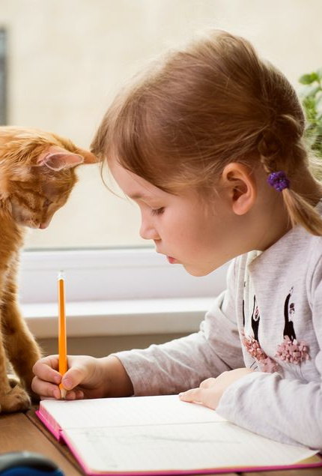
GREAT JOB, CLASS!
Remember
I, You, We, They = have got
He, She, It = has got
Keep looking at animals to see what body parts they have!

